Slide 1
Learning and Equilibrium Structure in Discrete Colonel Blotto
Regret-Matching Implementation with Symmetrisation
Scott Yap
CID: 02017478
Notes:
Hi, I’m Scott Yap. This project is about learning and equilibrium structure in the discrete Colonel Blotto game. (more narrative)

Slide 2
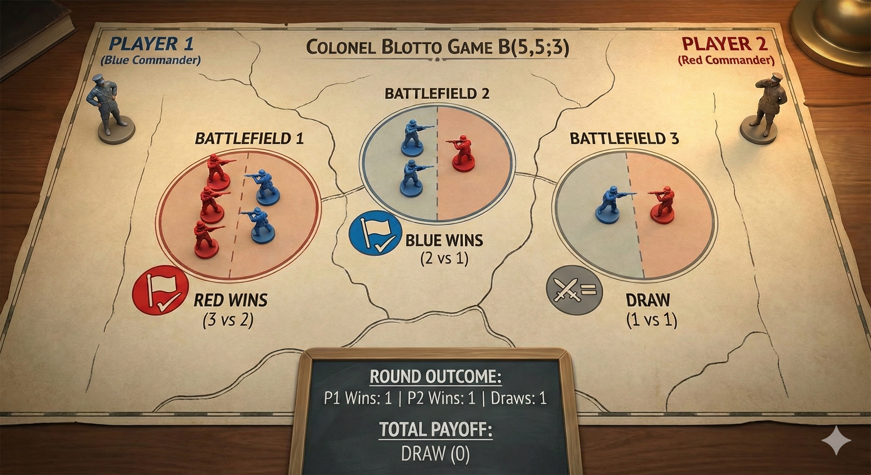
Notes:
Let me start with the game. In discrete Colonel Blotto, two players split a fixed number of troops across $K$battlefields.
In my experiments I focus on $B\left(5 , 5 , 3\right)$: each player allocates 5 troops across 3 battlefields, so a pure action is an integer triple like $\left(3 , 1 , 1\right)$with sum 5.
Each battlefield is scored independently: if you allocate more troops than your opponent on that battlefield, you win it; if you allocate fewer, you lose it; and ties are draws. The overall payoff is the average win–loss across battlefields — so it’s a zero-sum game.
The key difficulty is that even in small instances, the strategy space is huge: optimal play is a mixed strategy over many allocations, not one fixed split.”
“In this example, Red wins battlefield 1, Blue wins battlefield 2, and battlefield 3 is a draw — so the round payoff is zero.”

Slide 3
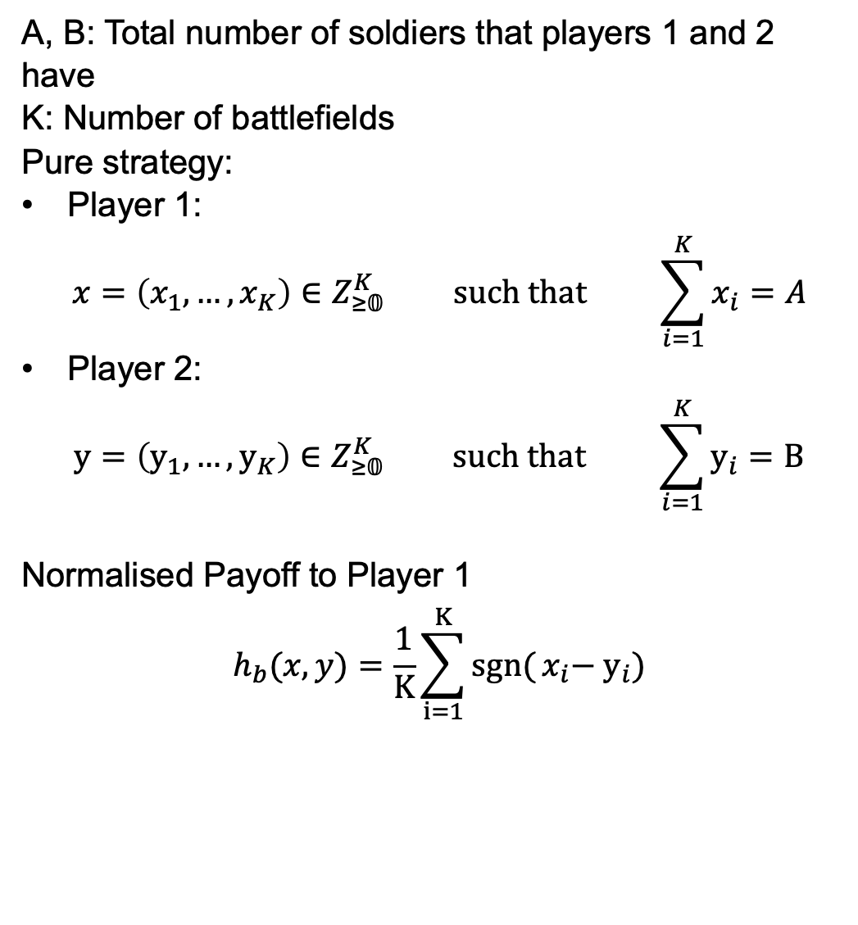
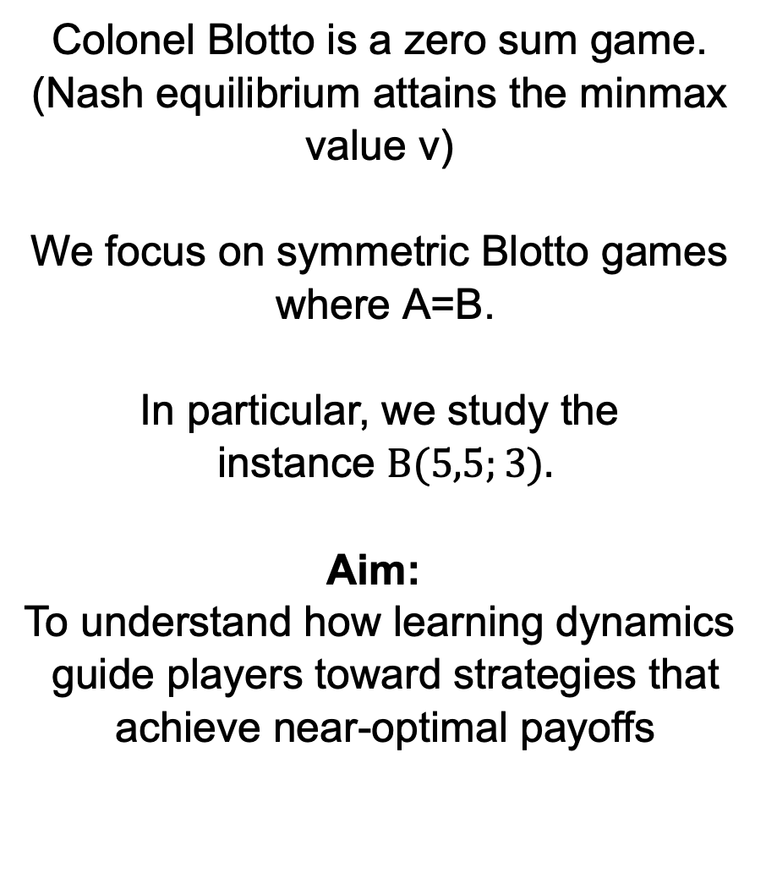
Math Formulation
Colonel Blotto (A,B;K)
A, B: Total number of soldiers that players 1 and 2 have
K: Number of battlefields
Pure strategy:
Player 1:
$$x=\left(x_{1},…,x_{K}\right)∈Z_{≥𝟘}^{K} \text{such} \text{that} \sum_{i=1}^{K}{x_{i}}=A$$
Player 2:
$$y=\left(y_{1},…,y_{K}\right)∈Z_{≥𝟘}^{K} \text{such} \text{that} \sum_{i=1}^{K}{y_{i}}=B$$
Normalised Payoff to Player 1
$$h_{b}(x,y)=\frac{1}{K}\sum_{i=1}^{K}{sgn⁡(}x_{i}−{ y}_{i})$$
Colonel Blotto is a zero sum game. (Nash equilibrium attains the minmax value v)
$\text{We} \text{focus} \text{on} \text{symmetric} \text{Blotto} \text{games} \text{where} \text{A}\text{=}\text{B}$.
$$\text{In} \text{particular}\text{, }\text{we} \text{study} \text{the} \text{instance} B(5,5;3).$$
$$\text{Aim}\text{: }$$
$$\text{To} \text{understand} \text{how} \text{learning} \text{dynamics} \text{guide} \text{players} \text{toward} \text{strategies} \text{that} \text{achieve} \text{near}\text{−}\text{optimal} \text{payoffs}$$
Notes:
“Here’s the mathematical formulation. Player 1 has $A$ troops and Player 2 has $B$, spread across $K$ battlefields. A pure strategy for Player 1 is an integer vector $x$with $components greater than or equal to 0$ and $sum of components =A$, and similarly Player 2 chooses $y$with $\sum_{i}{y_{i}}=B$.
Given pure strat $x$ and $y$, the normalised payoff to Player 1 is as such
where you get $+1$for a win, $−1$for a loss, and $0$for a tie on each battlefield, averaged across battlefields.
As mentioned this is a zero-sum game, so according to lecture notes. Nash equilibrium corresponds to the minimax value $v$. In this project I focus on the symmetric case $A=B$— in particular the instance $B\left(5 , 5 , 3\right)$— and the aim is to understand how learning dynamics drive players toward near-equilibrium behaviour.”

Slide 4



Theory
Algorithm
Hart: solving symmetric Blotto via General Lotto
Neller-Lanctot: no-external regret learning (regret matching)
We evaluate the results from Neller-Lanctot algorithm and compare with Hart’s theoretical results.
Notes:
My goal is to connect theory and computation: I use Sergiu Hart’s analytic solution as a benchmark in the symmetric setting, and I implement regret-matching (a no-external-regret learning algorithm from Neller–Lanctot) to see what strategies learning actually produces.

Slide 5
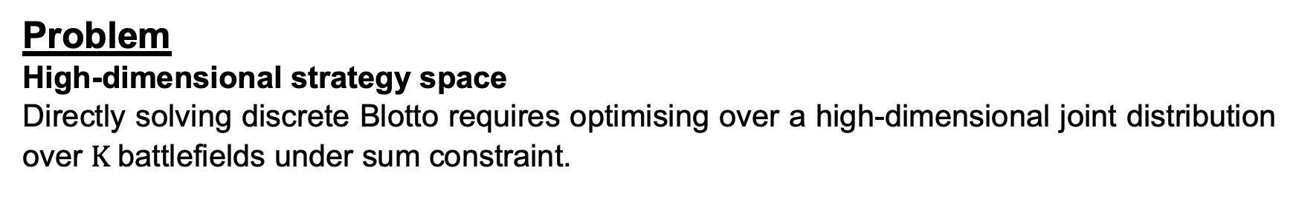
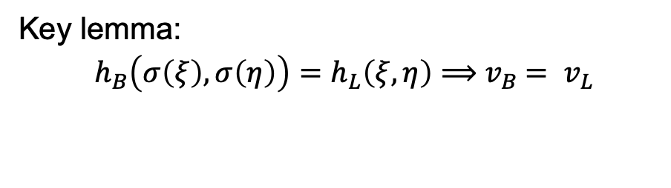
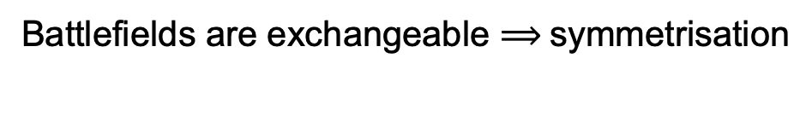
Discrete Colonel Blotto and General Lotto Games by Sergiu Hart
Motivation
Problem
High-dimensional strategy space
Directly solving discrete Blotto requires optimising over a high-dimensional joint distribution over $K$battlefields under sum constraint.
Solution (Reduction Pipeline)
Battlefields are exchangeable $⟹$ symmetrisation
Colonel Blotto
Colonel Lotto
General Lotto
Feasibility
Symmetrisation
Key lemma:
$$h_{B}\left(σ\left(ξ\right),σ\left(η\right)\right)=h_{L}\left(ξ,η\right)⟹{ v}_{B} = v_{L}$$
Colonel Lotto:
Focus on permutation-invariant play -> 1D marginal problem.
Notes:
Let’s start with the theory. Hart’s paper explains why discrete Blotto is hard — and then gives a really elegant way to simplify it.
The difficulty is the strategy space. A mixed strategy in discrete Blotto is a probability distribution over all integer allocations across $K$battlefields — so equilibrium computation is essentially optimising over a huge, high-dimensional joint distribution under a sum constraint.
Hart’s key observation is exchangeability: battlefield labels are just names. If we relabel battlefield 1 and 2 for both players’ allocations, the payoff doesn’t change. That symmetry motivates symmetrisation: take any mixed strategy and average it over all permutations of battlefield labels.
The key lemma is that, after symmetrisation, Blotto becomes payoff-equivalent to Colonel Lotto — and in particular the minimax value is preserved.
So instead of solving Blotto directly, Hart reduces to Colonel Lotto, where only the one-dimensional marginal distribution matters.

Slide 6
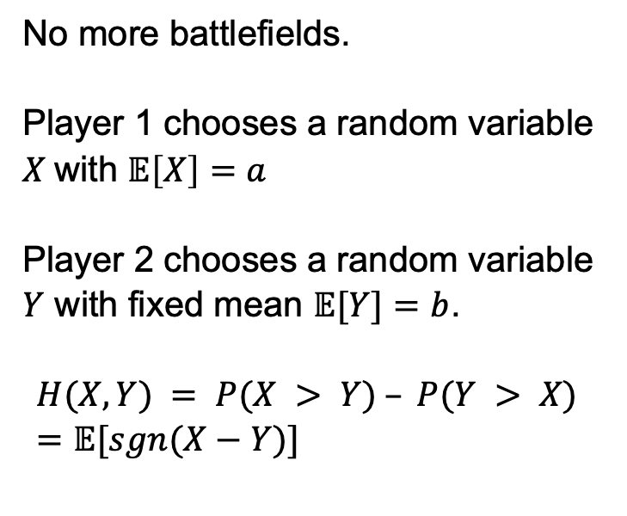
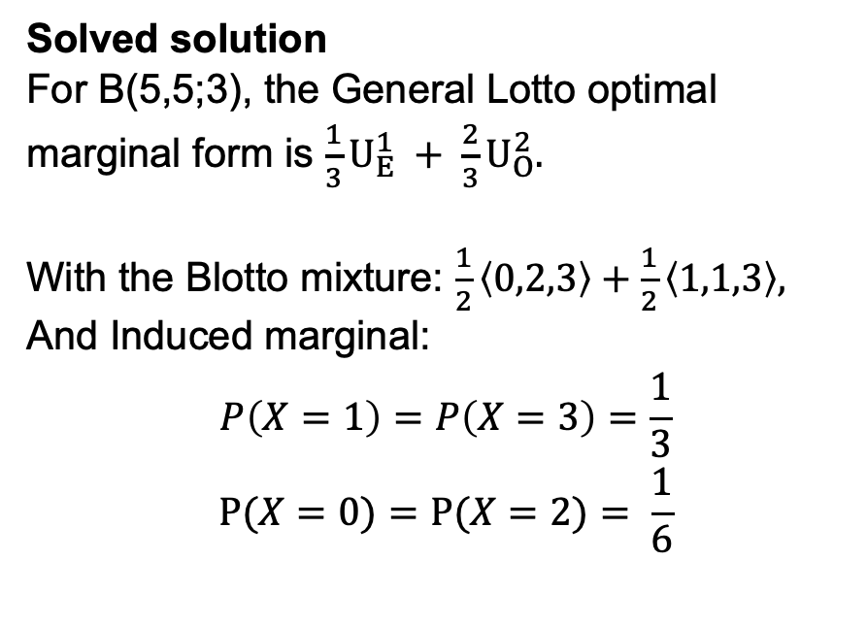
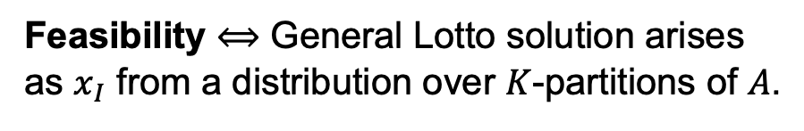
General Lotto and Colonel Solution
Reduction and Feasibility
General Lotto (the relaxation)
Feasibility $⟺$ General Lotto solution arises as $x_{I}$ from a distribution over $K$-partitions of $A$.
No more battlefields.
Player 1 chooses a random variable $X$with $𝔼\left[X\right]=a$
Player 2 chooses a random variable $Y$ with fixed mean $𝔼[Y]=b$.
$$H(X,Y) = P(X > Y) – P(Y > X) =𝔼[sgn⁡(X−Y)]$$
Solved solution
For B(5,5;3), the General Lotto optimal marginal form is $\frac{1}{3}U_{E}^{1} + \frac{2}{3}U_{O}^{2}.$
With the Blotto mixture: $\frac{1}{2}\left\langle 0,2,3\right\rangle +\frac{1}{2}\left\langle 1,1,3\right\rangle ,$
And Induced marginal:
$$P\left(X=1\right)=P\left(X=3\right)=\frac{1}{3}$$
$$Ρ(X=0)=P(X=2)= \frac{1}{6}$$
Hart solves both Continuous and Discrete General Lotto
Notes:
“Next, Hart connects Colonel Lotto to an even simpler relaxation: General Lotto.
In General Lotto there are no battlefields. Player 1 chooses a random variable $X$— integer-valued in the discrete case, real-valued in the continuous case — with a fixed mean $𝔼\left[X\right]=a$. Player 2 chooses $Y$with $𝔼\left[Y\right]=b$. The payoff is the same win–lose comparison, written in terms of $sgn\left(X−Y\right)$.
So the game becomes: choose a distribution with the right mean that performs well against the opponent’s distribution.
Hart solves both the continuous and discrete General Lotto problems explicitly. For our symmetric Blotto instance $B\left(5 , 5 , 3\right)$, this gives a closed-form target marginal.
The final step is feasibility: this marginal only matters for Blotto if it can be realised as the distribution of the troop count on a uniformly random battlefield, under some mixed strategy over $K$-partitions of $A$.
In $B\left(5 , 5 , 3\right)$, feasibility holds. Hart even constructs an explicit Blotto mixture — for example $\frac{1}{2}\left(0 , 2 , 3\right)+\frac{1}{2}\left(1 , 1 , 3\right)$— which produces exactly the target marginal shown here.”

Slide 7
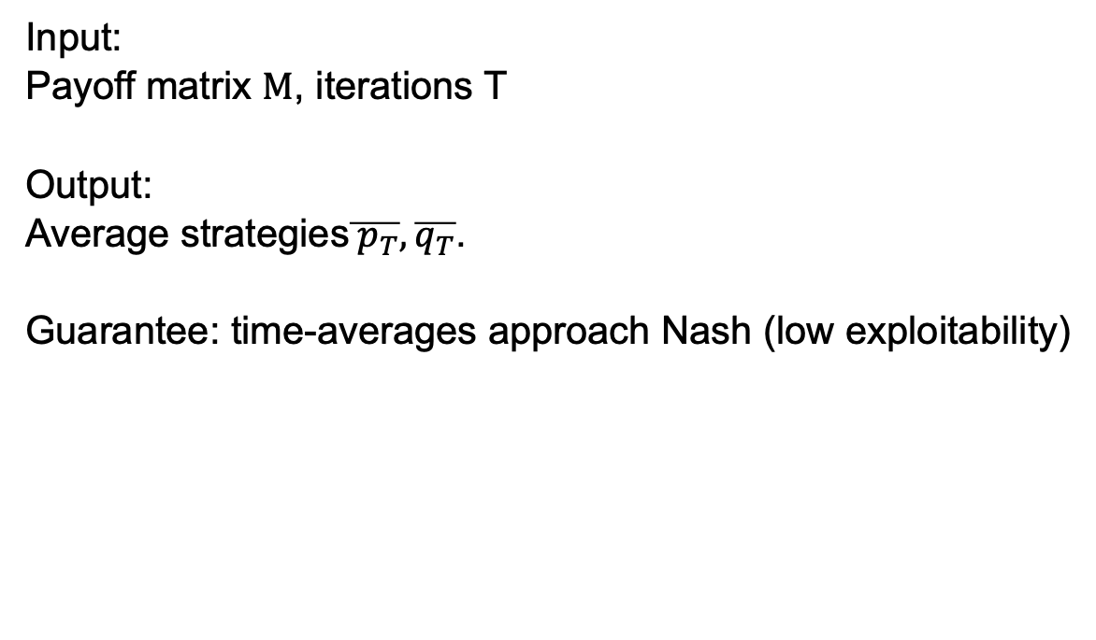
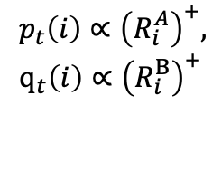
Regret Matching Implementation by Neller and Lanctot
Algorithm
Regret Matching Algorithm
Regret-matched strategy
Accumulate average
Sample Play
Regret Update
Input:
Payoff matrix $M$, iterations T
Output:
Average strategies$\overline{{ p}_{T}}, \overline{q_{T}}$.
Guarantee: time-averages approach Nash (low exploitability)
$p_{t}​\left(i\right)∝{\left(R_{i}^{A}​\right)}^{+},$
$$q_{t}​\left(i\right)∝{\left(R_{i}^{B}​\right)}^{+}$$
Notes:
Now, we move onto the second half of the project where I implement regret matching in self-play.
At each step, each player plays a mixed strategy proportional to positive cumulative regret, samples an action, updates regrets from the realised payoff, and accumulates the average. The output is the time-averaged strategies ${\overset{ˉ}{p}}_{T},{\overset{ˉ}{q}}_{T}$.
The key guarantee is that in two-player zero-sum games, these time-averages drive regret to zero, so exploitability drops and the averages approach the Nash set.”

Slide 8
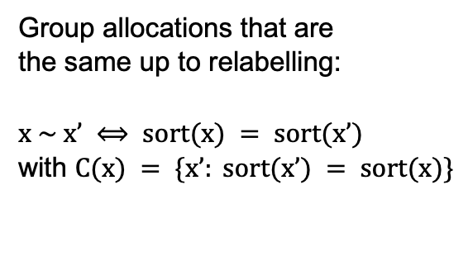
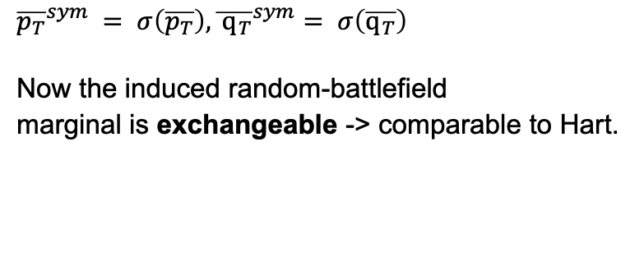
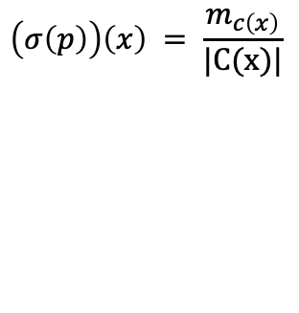
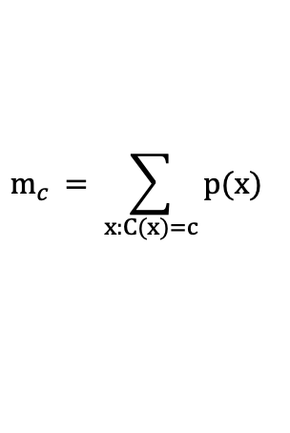
My Addition step to the Regret Matching Implementation
Symmetrisation for Hart Comparison
Hart’s prediction is for exchangeable (symmetrised) play,
so I symmetrise the final time-averages before comparing marginals.
Permutation Class
Accumulate class mass
Redistribute uniformly within each class
Group allocations that are
the same up to relabelling:
$x \sim x’ ⟺ sort(x) = sort(x’)$
with $C(x) = \{x’: sort(x’) = sort(x)\}$
$$m_{c }= \sum_{x:C(x)=c}{p(x)}$$
$$\left(σ\left(p\right)\right)\left(x\right) = \frac{m_{c\left(x\right)}}{|C(x)|}$$
Output
$${\overline{p_{T}}}^{sym} = σ\left(\overline{p_{T}}\right),{\overline{ q_{T}}}^{sym}= σ\left(\overline{q_{T}}\right)$$
Now the induced random-battlefield
marginal is exchangeable -> comparable to Hart.
Notes:
Hart’s theoretical prediction is stated for exchangeable play, meaning the game doesn’t change if we relabel the battlefields for both players.
But regret matching outputs a mixed strategy over labelled allocations, so before comparing to Hart, I apply a symmetrisation operator to the final time-averages.
The idea is: allocations that only differ by permuting coordinates belong to the same permutation class.
So first I group allocations by their sorted pattern $c\left(x\right)=sort\left(x\right)$.
Then I accumulate the total probability mass in each class:
$$m_{c}=\sum_{x: c\left(x\right)=c}{p}\left(x\right).$$
Finally I redistribute that mass uniformly over the class, defining
$$\left(σ\left(p\right)\right)\left(x\right)=\frac{m_{c\left(x\right)}}{∣C\left(x\right)∣}.$$
Applying this to the learned averages gives
$${\overset{ˉ}{p}}_{T}^{\text{sym}}=σ\left({\overset{ˉ}{p}}_{T}\right), {\overset{ˉ}{q}}_{T}^{\text{sym}}=σ\left({\overset{ˉ}{q}}_{T}\right).$$
Now the induced random-battlefield marginal is exchangeable, so I can directly compare it to Hart’s marginal.”

Slide 9
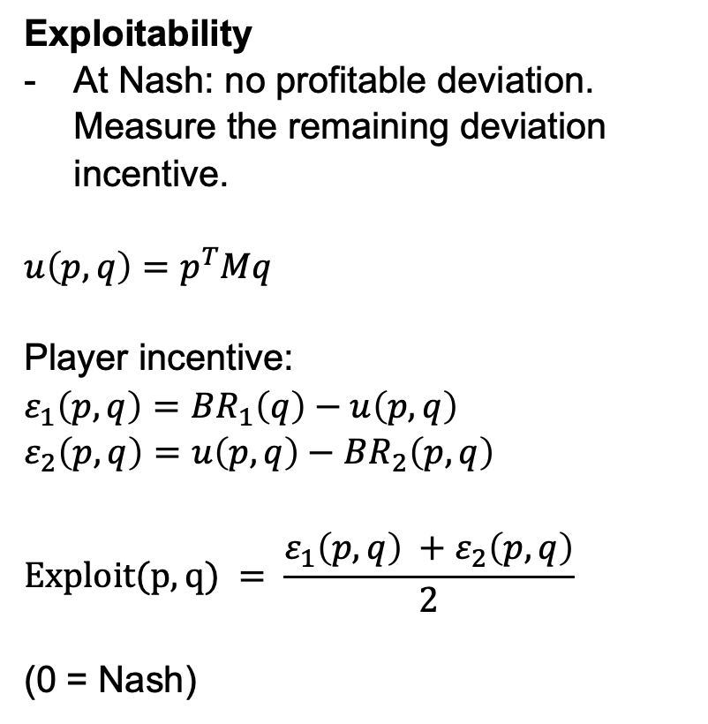
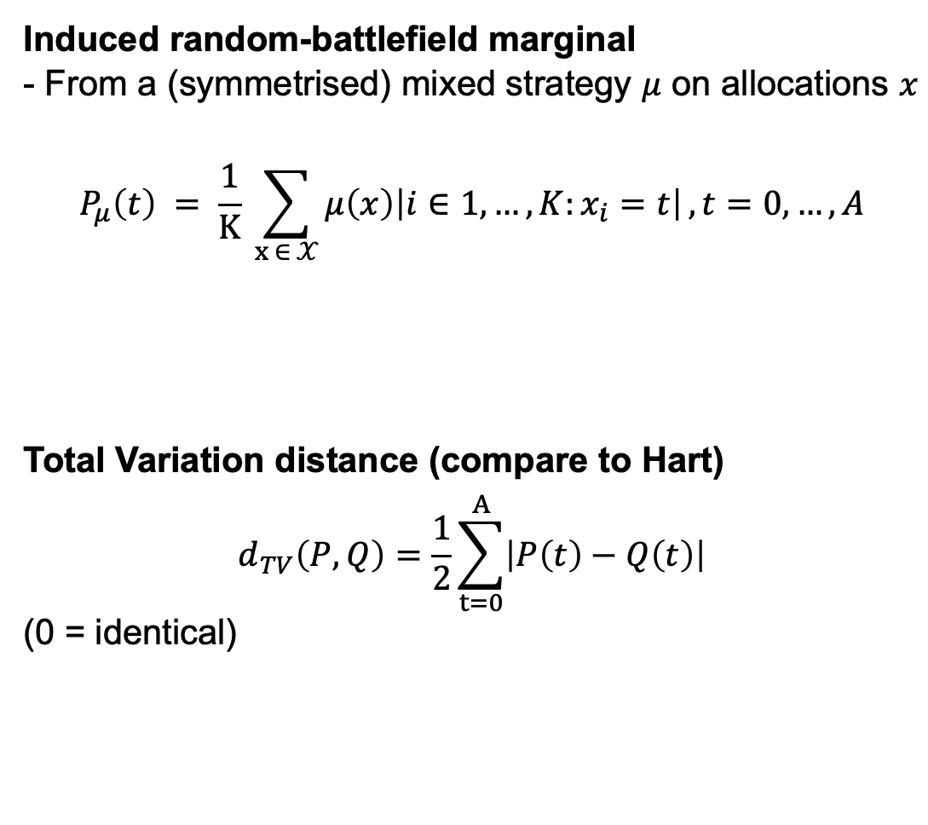
Metrics
Exploitability and Total Variation Distance
Exploitability
At Nash: no profitable deviation. Measure the remaining deviation incentive.
$$u\left(p,q\right)=p^{T}Mq$$
Player incentive:
$$ε_{1}\left(p,q\right)=BR_{1}\left(q\right)−u\left(p,q\right)$$
$$ε_{2}\left(p,q\right)=u\left(p,q\right)−BR_{2}\left(p,q\right)$$
$$Exploit(p,q) = \frac{ε_{1}\left(p,q\right) +ε_{2}\left(p,q\right)}{2}$$
(0 = Nash)
Induced random-battlefield marginal
- From a (symmetrised) mixed strategy $μ$ on allocations $x$
$$P_{μ}\left(t\right) = \frac{1}{K} \sum_{x ∈ 𝒳}{μ\left(x\right)\left|i∈1,…,K:x_{i}=t\right|}, t=0,…,A$$
Total Variation distance (compare to Hart)
$$d_{TV}\left(P,Q\right)=\frac{1}{2}\sum_{t=0}^{A}{\left|P\left(t\right)−Q\left(t\right)\right|}$$
(0 = identical)

Slide 10
My implementation
Game enumeration → RM self-play → evaluation (exploitability, induced marginals, TVD) → UMAP visualisation.

Slide 11
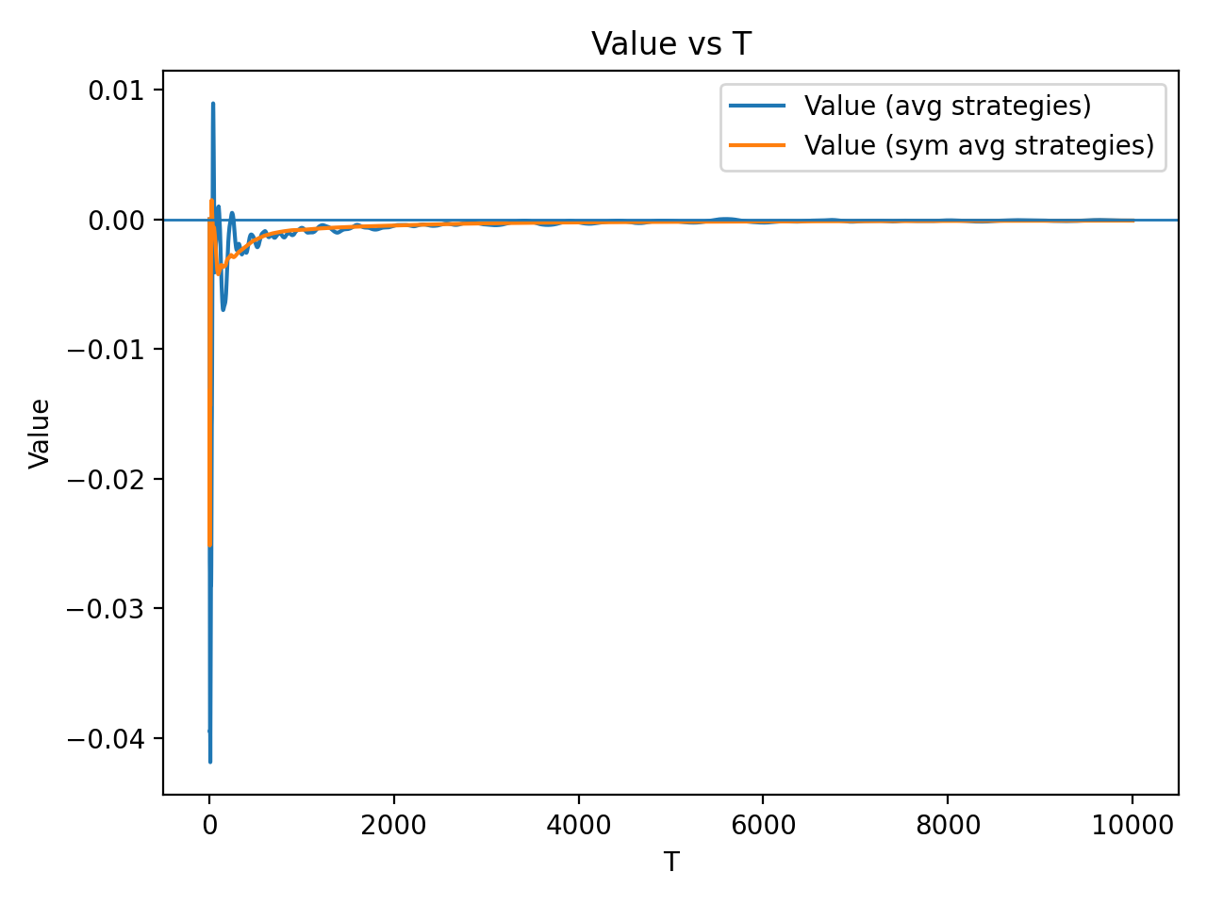
Results 1: Value

Slide 12
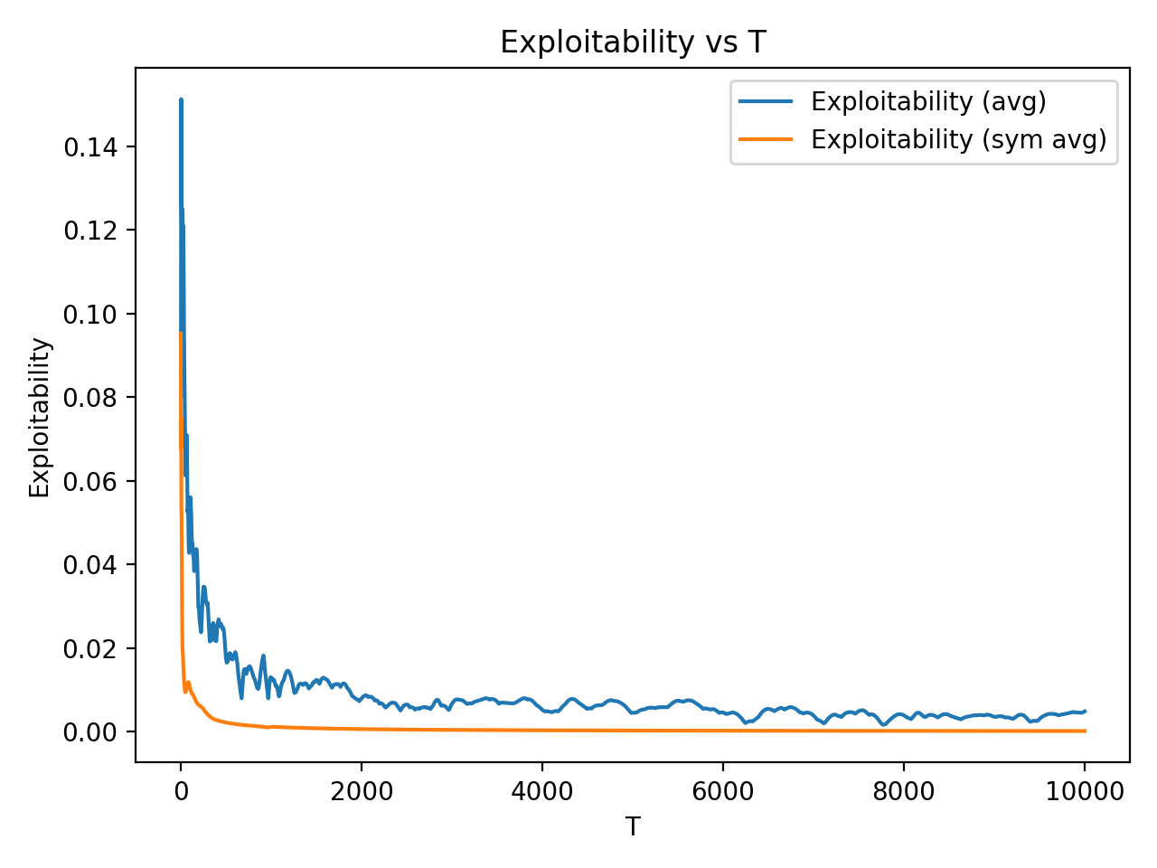
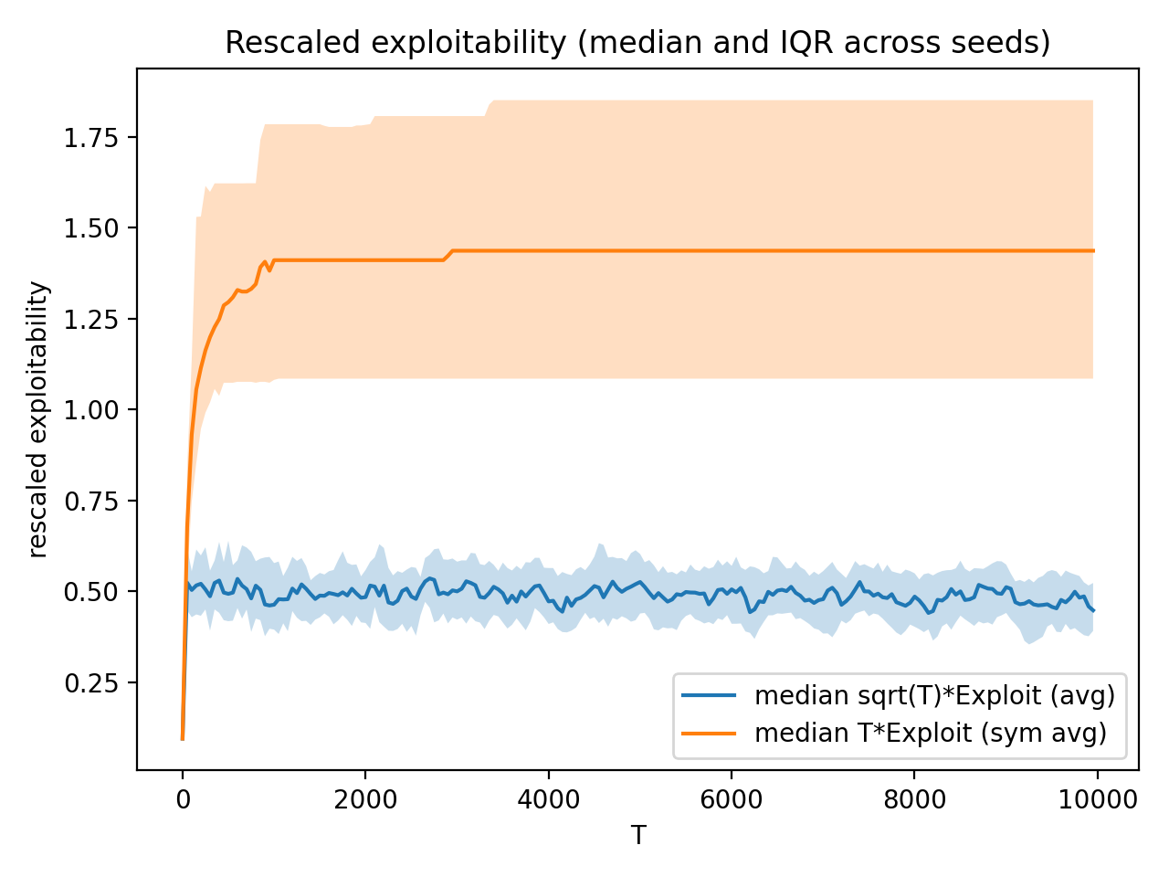
Results 2: Convergence to Nash

Slide 13
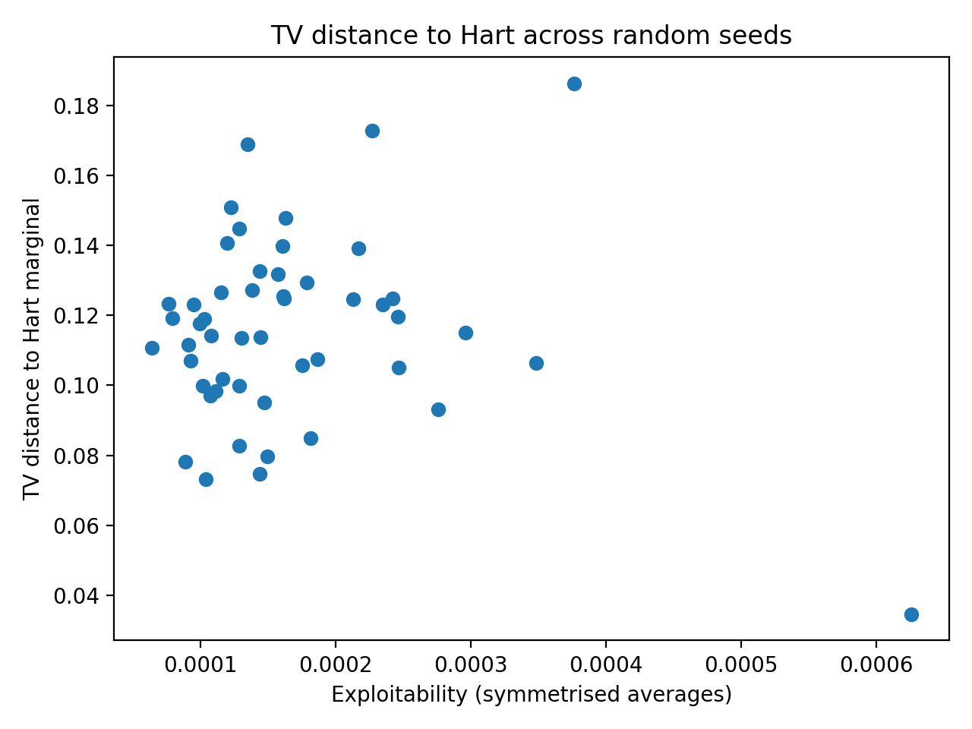
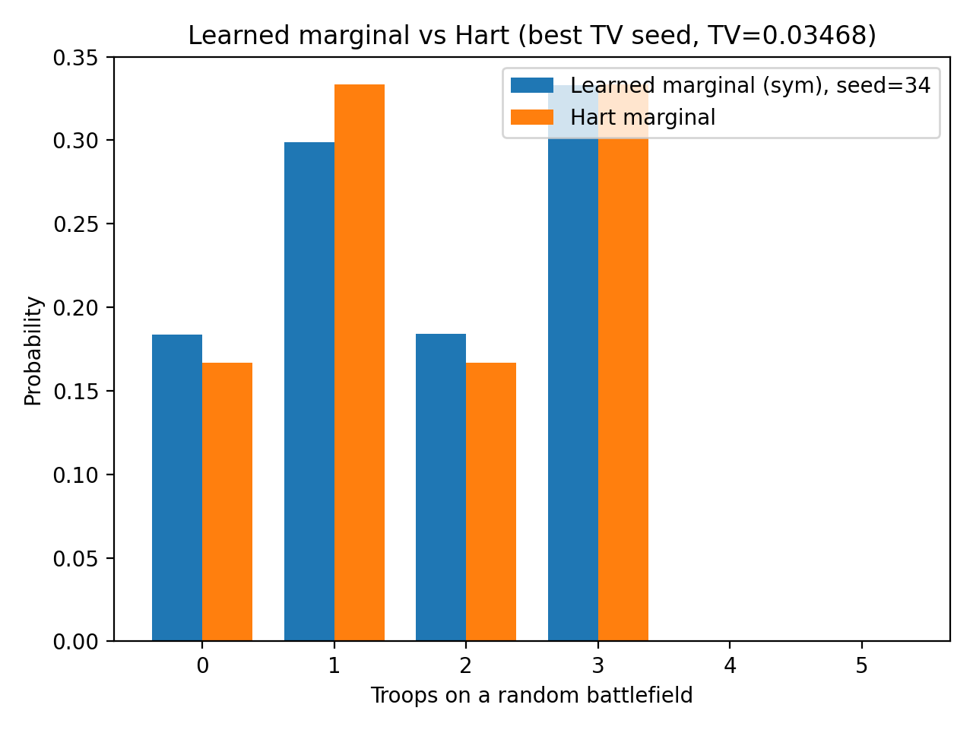
Results 3: Hart marginal vs learned marginal

Slide 14
Takeaway
Learning and Equilibrium Structure in Discrete Colonel Blotto
Theory benchmark: Hart solves the exchangeable/symmetrised Blotto structure and predicts a target marginal.
Learning verification: Regret-matching reaches low exploitability (near Nash).
Geometry insight: Nash is a set. Different runs land in different equilibrium regions. Hart’s marginal is one equilibrium-consistent outcome, not uniquely selected.
Notes:
Theory (Hart): In the symmetric discrete setting, battlefield labels are exchangeable. Hart exploits this by symmetrising Blotto, reducing it to Colonel/General Lotto, and deriving equilibrium value + equilibrium-consistent marginals.
Algorithm (Neller–Lanctot): I implemented no-external-regret / regret-matching self-play on the finite $\left(S , K\right)=\left(5 , 3\right)$game and evaluated convergence via exploitability.
Verification: The time-averaged strategies reach low exploitability (near the Nash set), consistent with regret-learning theory.
Main insight (geometry of equilibrium): The Nash equilibrium is a set, not a single point: different runs converge to different low-exploitability strategies. The symmetric Nash set lies inside the full Nash set, and Hart’s prediction corresponds to one equilibrium-consistent marginal within that symmetric set, not a unique outcome.

Slide 15
Thank you QnA
Learning and Equilibrium Structure in Discrete Colonel Blotto

